Slide 1
Countries and Nationalities
Basic 1 – Unit 2 a – Countries of the world

Slide 2
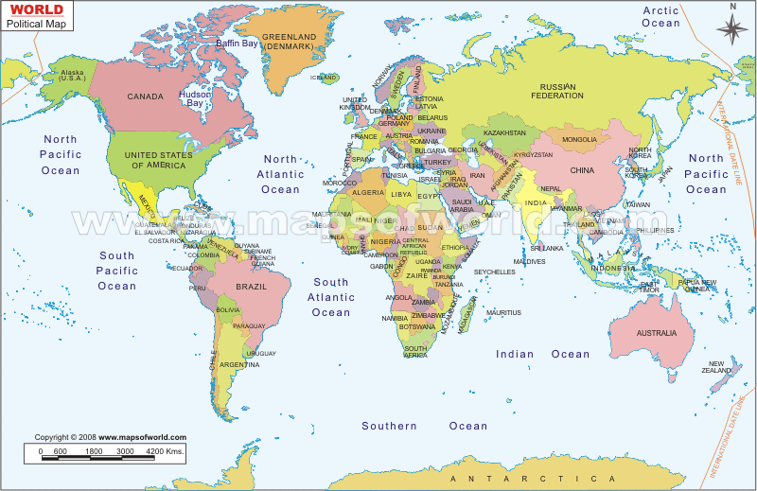

Slide 3
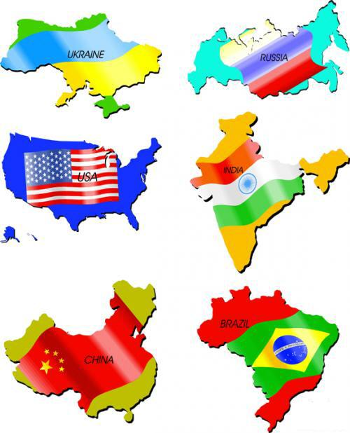

Flag

Slide 4
CANADA JAPAN THE UNITED STATES
RUSSIA AUSTRALIA CHINA

Slide 5
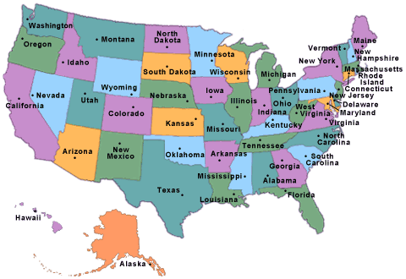
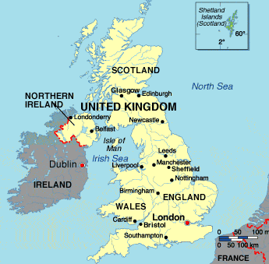
The United States
The United Kingdom

Slide 6
The United States

Slide 7
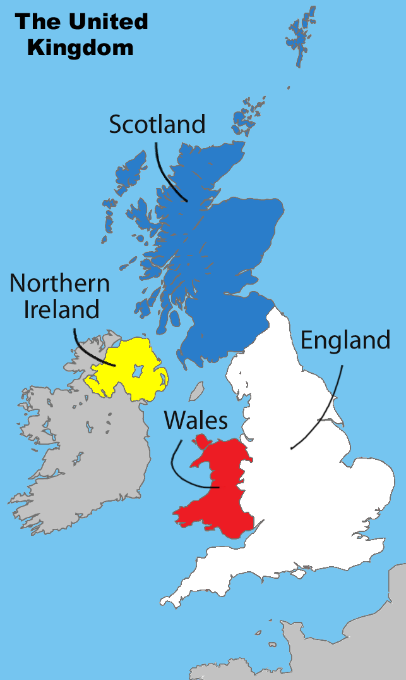

Slide 8
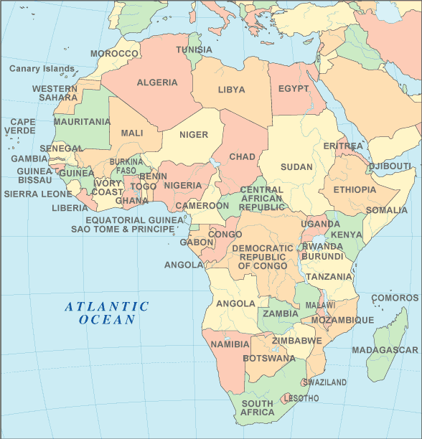

Slide 9
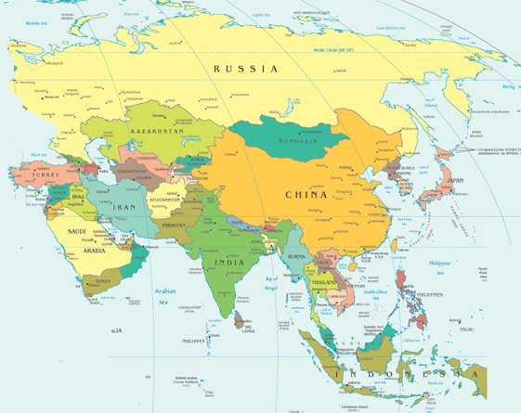

Slide 10
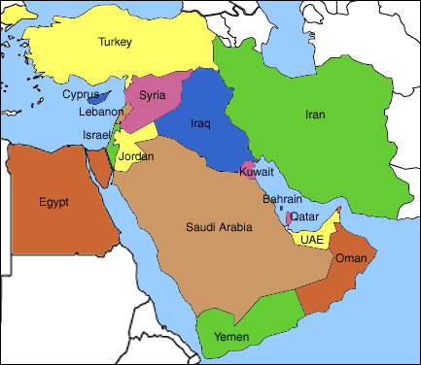

Slide 11
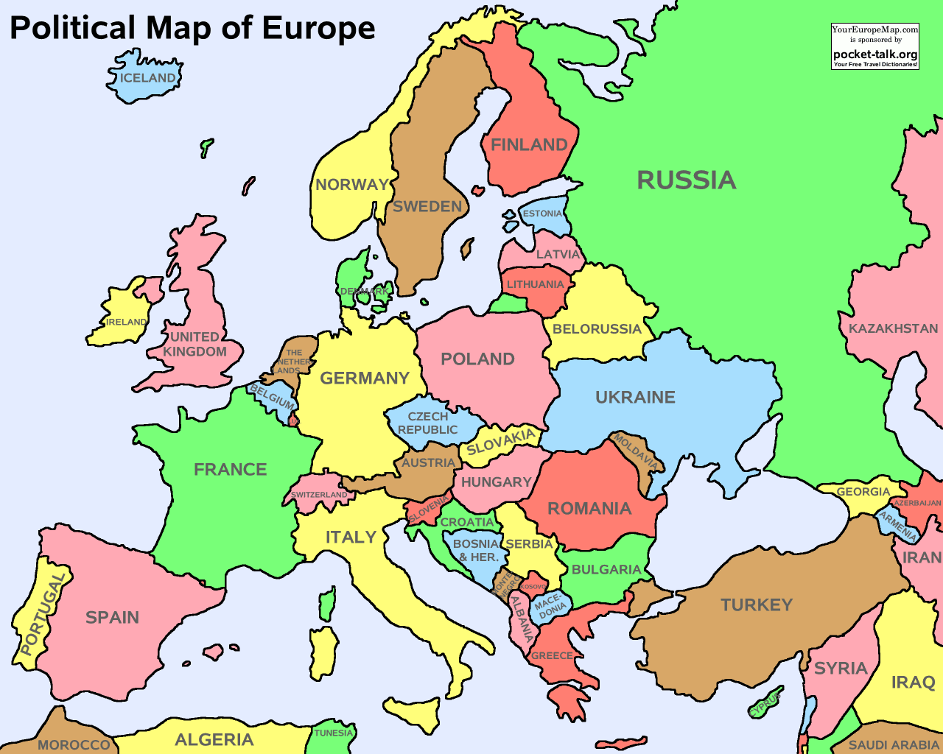

Slide 12
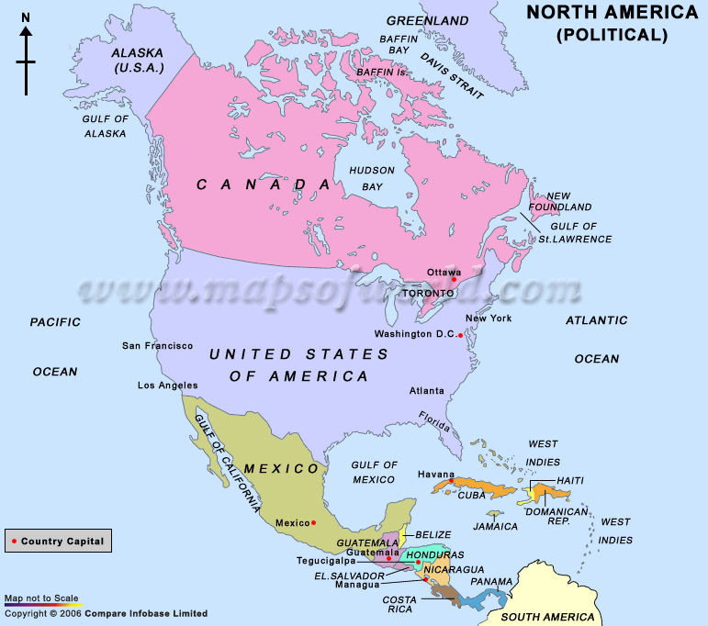

Slide 14
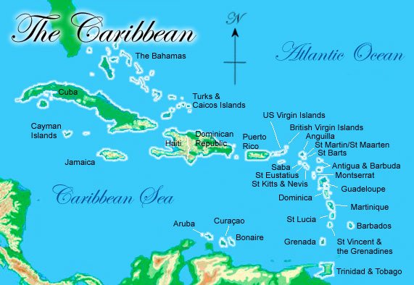

Slide 15
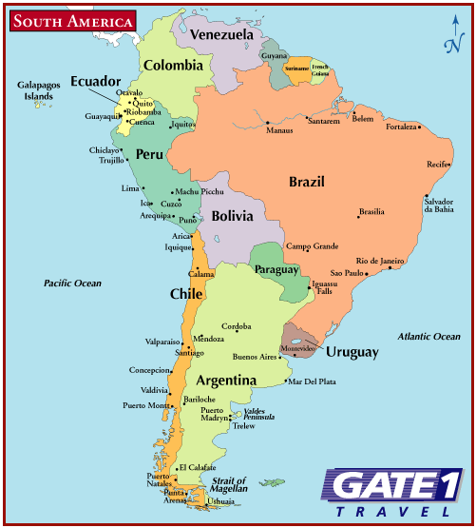

Slide 16
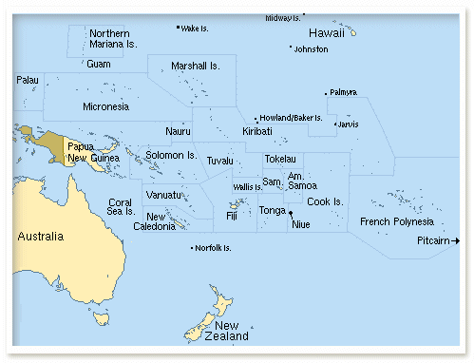

Slide 17
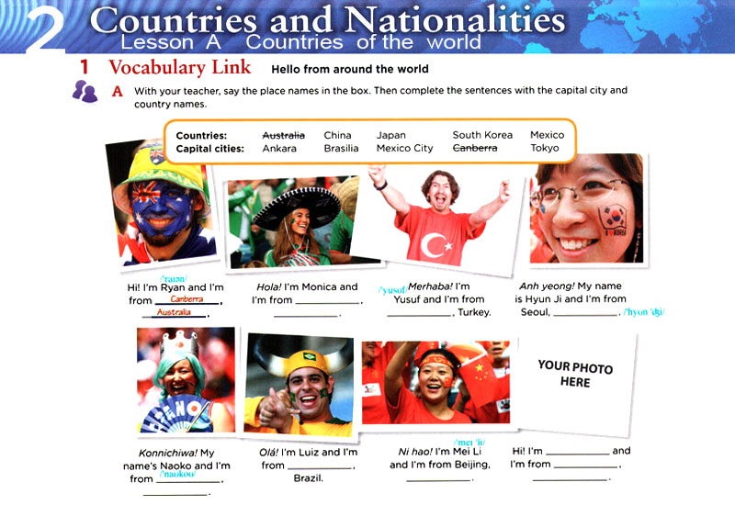
Who´s he?
Who´s she?
He´s Ryan.
She´s Monica.
Where´s he from?
Where´s she from?
He´s from Canberra, Australia.
She is from Mexico City, Mexico.

Slide 18
Who´s he?
He´s Ryan. He is Australian, he´s from Canberra, Australia. He speaks English.
He´s (name). He is (nationality), he´s from (city), (country). He speaks (language).

Slide 19
Who´s she?
She´s Monica. He is Mexican, he´s from Mexico City, Mexico. She speaks Spanish.
She´s (name). She is (nationality), she´s from (city), (country). She speaks (language).

Slide 20
Who´s she / he?
He´s (name). He is (nationality), he´s from (city), (country). He speaks (language).
She´s (name). She is (nationality), she´s from (city), (country). She speaks (language).

Slide 21
A: Australia !
B : People from (country) are (nationality), The capital of (country). is (city). They speak (language).
Australia
Australian
Australia
Canberra
English.

